Slide 1
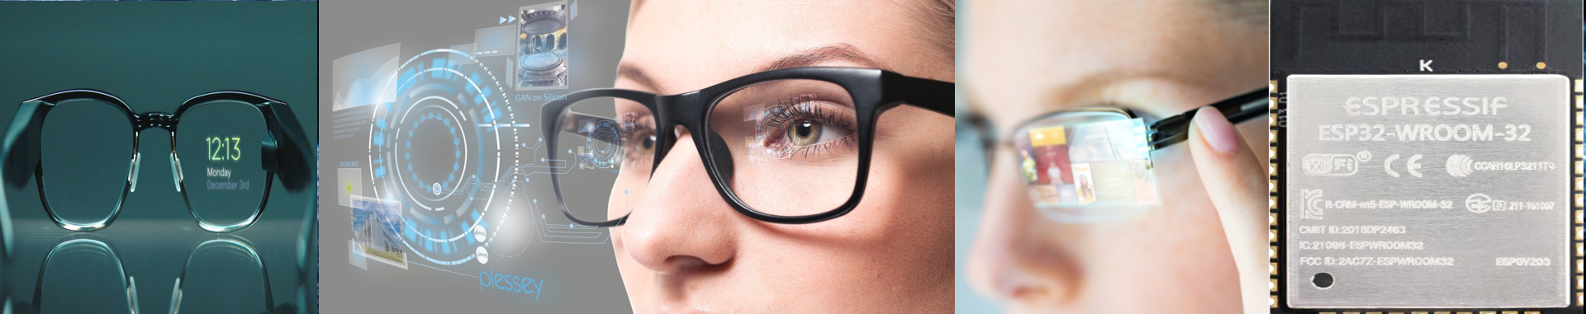

Smart Wearable Technology: Smart-Glass

Slide 2
Smart Wearable Technology: Smart-Glass
MAJOR PROJECT PRESENTATION
SCHOOL OF ELECTRONICS ENGINEERING
KIIT Deemed to be University, Patia,
Bhubaneswar- 751024, Odisha
Guided By:
Dr. Nirmal Kumar Rout
Professor, School of Electronics Engineering, KIIT University
Date: 12-04-2022
Presented by:
Ayush Dev (1804160)
Shubham Saxena (1804199)
Siddhant Pandey (1804200)
Sourav Das (1804206)
ETC-3, School of Electronics Engineering,
KIIT University, Patia, Bhubaneswar

Slide 3


Presentation Overview
Introduction
Previous Work
Innovations
Proposed Model
Results
Milestone
Conclusion

Slide 4
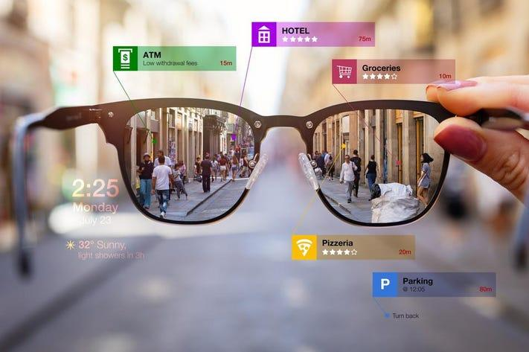
Introduction
Smart glass is one of the wearable device that is capable of handling a wide range of computing activities that an ordinary human cannot do.
Smart glasses are wearable computer glasses that add information alongside or to what the wearer sees.
The Basic idea of smart glass implementation, its interaction and applications of smart glasses in daily life.
Smart glass has the capability to increase the productivity of the user along with ease of use.
Smart Glass Example

Slide 5
Previous Work
In the present scenario, there are several smart glasses technologies available in the market which are from Google glass, Epson, Meta-Pro, Vuzix.
For example : Google glasses were available in the market for about $999 (latest version). Currently Google only provides these glasses to corporates or for training purpose in different firms and provides features like :-
Navigation, GPS and
Compass
Messaging
Calls via a smartphone
Google Search
Taking Pictures/ Videos
Video Conference
Social Media
News Headlines
Google Music

Slide 6
Previous Work…
Epson, Bosch and Vuzix also provides similar features like Google glass and their pricing is also similar to google.
There are also some other published work available on smart glasses which lacks some of the important features, which we are going to cover.
One of the published work which we found is the model for visually impaired people to assist them for walking by alerting them about the obstacle in front of them using ultrasonic sensor and camera. But this system has some flaws which are as follows

Slide 7
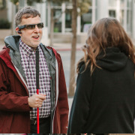
Innovations
The Smart glasses that we are presenting will have most of the features that are currently available in the market but will also have some unique features like :-
Support for Blinds
Native ML Model
Gestures & Eye blink Detection
Touch Sensor
Smart Glass for Visually Impaired People

Slide 8
Innovations…
Offline image processing to produce results when mobile phone is not connected to internet.
Object detection focusing for blinds along with the corresponding audio.
Obstacle avoidance assistance for blinds
Text/sign to speech
Photo and video recording
Navigation assistance
Activity Tracking
Notifications from various mobile apps etc.
So we are planning to avail these Smart glasses at affordable prices and our glasses will also have some extra features as mentioned earlier.

Slide 9
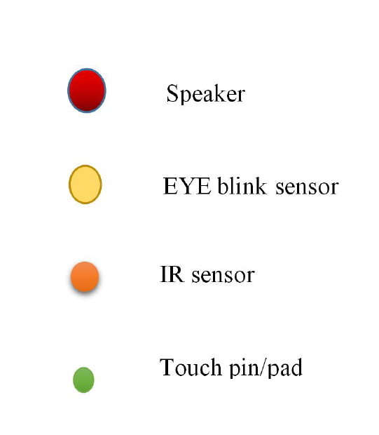
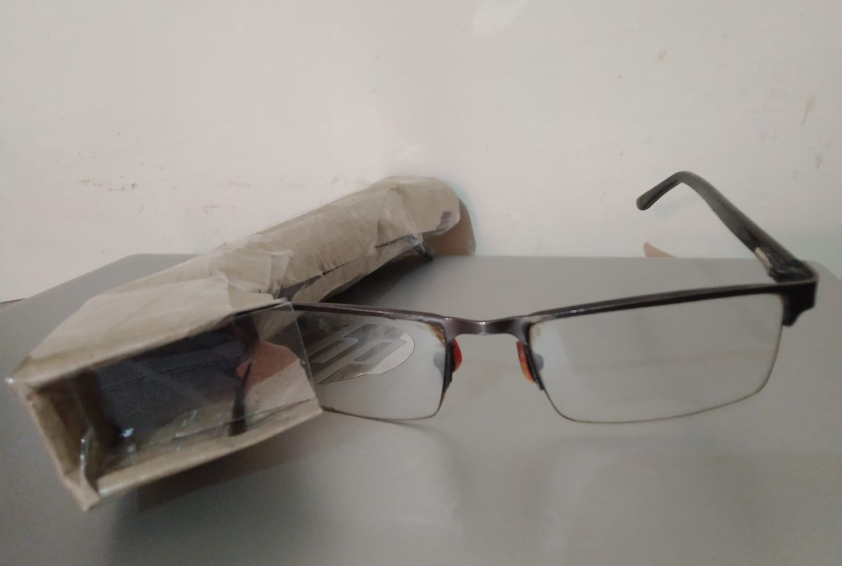
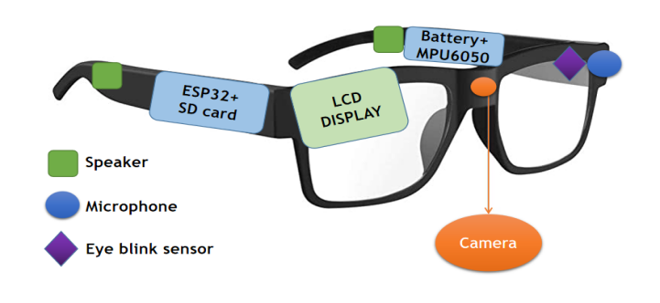
Proposed Model
Design & Model
Smart-glass prototype
Model of smart-glass

Slide 10
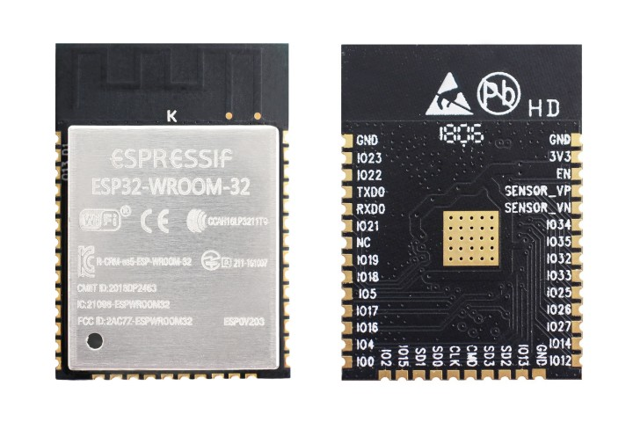
Proposed Model...
Main MCU
ESP32 Based Microcontroller is used, some of its features are:
32-bit, Dual core
Ultra low power
Clock speed 160/240 MHz
Wi-Fi + BLE, Bluetooth v4.2
UART, I2C, SPI, CAN, I2S
Deep-sleep (5u-Amp)
4MB flash memory
8MB PSRAM
ESP32 Module

Slide 11
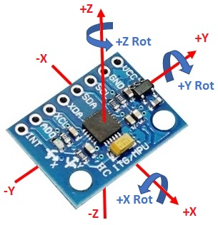
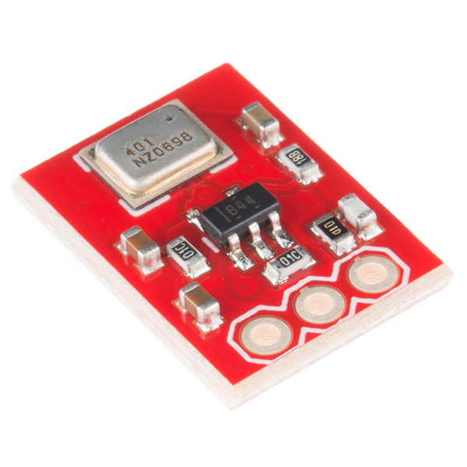
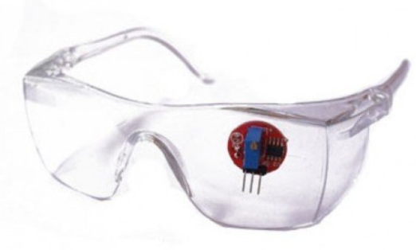
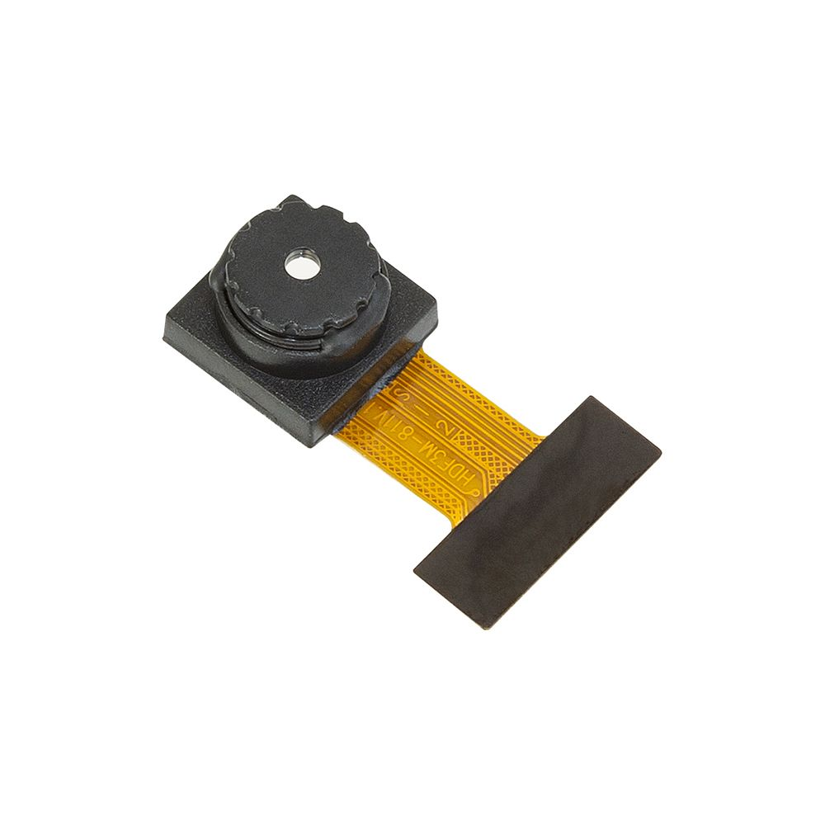
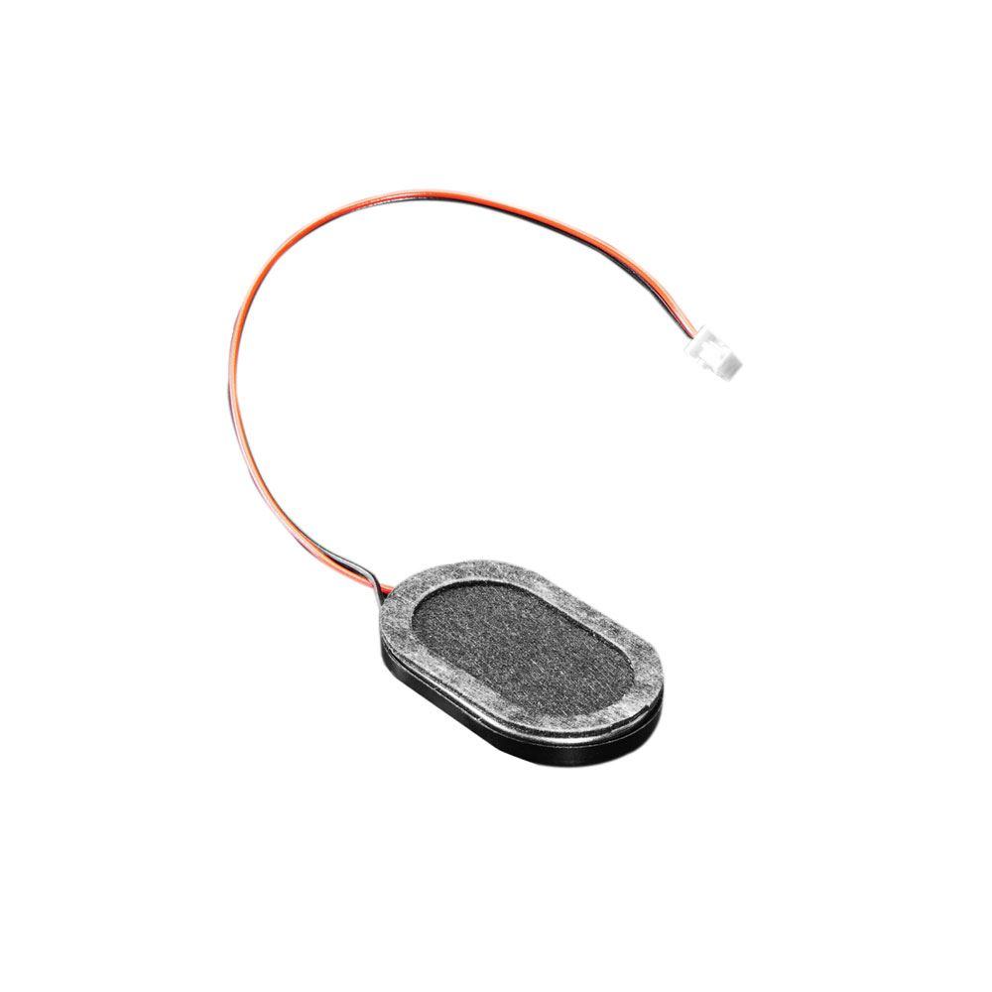
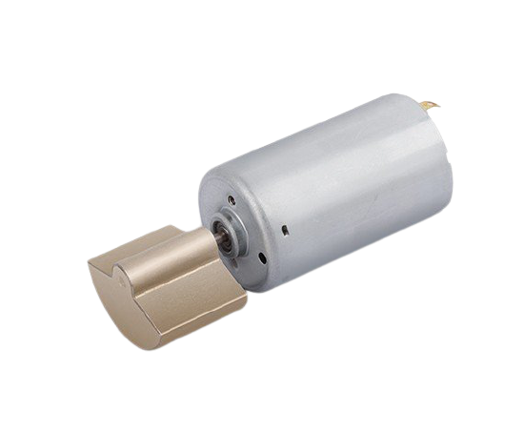
Proposed Model...
Sensors
MIC & Speaker
Vibrator
MPU 6050
Eye blink sensor
2MP OV2640 camera
Mems Mic
TFT Display
SD card slot
MEMS MIC
Eye- blink sensor
MPU 6050
Speaker
OV2640 camera
Vibrator

Slide 12
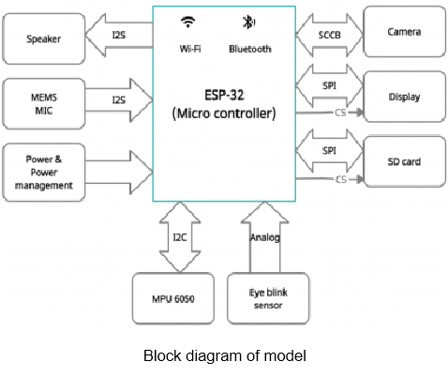
Proposed Model...
Connection Block Diagram

Slide 13
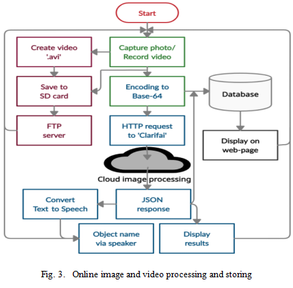
Proposed Model...
Image & Video Processing
The images taken are encoded to base-64.
HTTP request to Cloud ML model with base-64 data.
JSON response is processed to display data on screen.
Text to speech is done and fed to speaker.
Some of the important data is also stored in local database.
Flowchart of Image & Video Processing

Slide 14
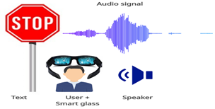
Proposed Model...
Offline Text to Speech
Conversion of detected object to speech.
Helpful feature for visually impaired person.
When any object is detected, the ‘.wav’ file of that particular object from the SD card is fed to the speaker .
Text to speech conversion

Slide 15
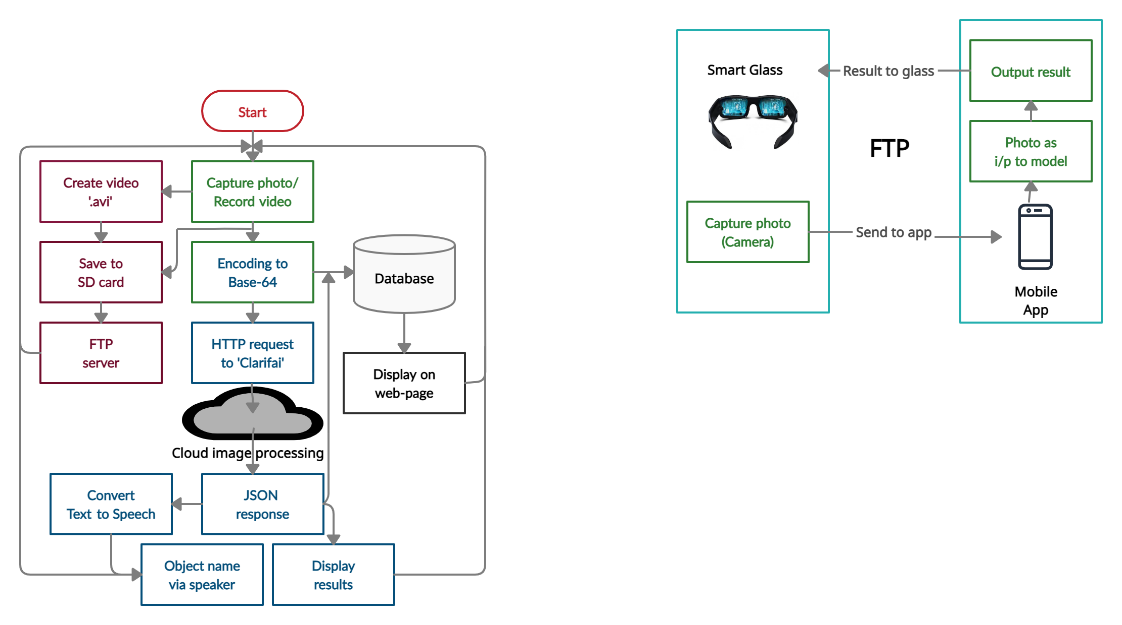
Proposed Model...
File Transfer Using FTP
The image data and results are transferred between the mobile application and the smart-glass using FTP protocol.
File transfer between smart-glass and mobile using FTP

Slide 16
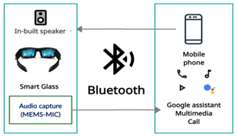
Proposed Model...
Other features
Calling and Listening Music: Users can use this smart-glass as a Bluetooth music device. With the help of an in-built microphone and speaker, one can make phone calls, listen to music, etc. The device uses Bluetooth A2DP for sending and receiving voice signals.
Google Assistant Support: Nowadays virtual assistants are very useful tools for productivity. Google Assistant has proved to be one of the best virtual assistants. The proposed smart glass is also going to have the assistant feature, users can use it anytime when connected to the phone via Bluetooth.

Slide 17
Proposed Model...
Other features
Eye-blink Detection: The eye-blink detection sensor is one type of infra-red sensor. Using this sensor the micro-controller is able to detect if the eye of the user is closed or open. It may be a great help to the user while driving. If the user feels sleepy, the sensor detects it.
Gesture Controlling: For seamless interfacing of the smart-glass the gestures like nodding the head up and down, are going to be an additional feature for the user to operate the smart-glass. These functionalities are implemented by the MPU6050 accelerometer sensor
Movement Tracking: The user’s physical activity and energy loss are calculated by using MPU6050 gyroscope accelerometer sensor data, with the help of this data the number of steps taken while walking or running are calculated.

Slide 18
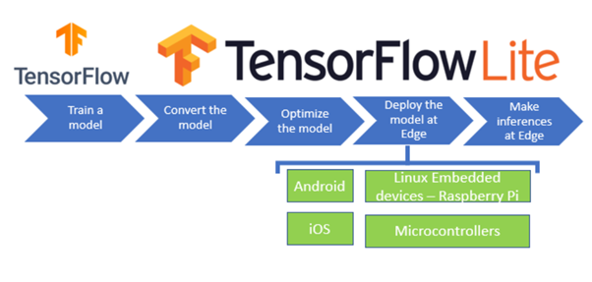
Proposed Model...
ML Model: Tensorflow Object detection API
Object detection is a computer technology related to computer vision and image processing that deals with detecting instances of semantic objects of a certain class (such as humans, buildings, or cars) in digital images and videos.
TensorFlow object detection API is the framework required to create a deep learning Network that solves everyday object detection problems
Fig.-Flowchart of TensorFlow Lite

Slide 19
Proposed Model...
Yolo Stands for You Only Look Once. As it name suggests it is talking about speed.
YOLO is based on a single Convolutional Neural Network (CNN). The CNN divides an image into regions and then it predicts the boundary boxes and probabilities for each region.
It is the 4th addition to the family of YOLO object detector models. It was released with the concept of BoF (bag of freebies) and BoS (bag of specials) techniques to enhance model performance.
It can estimate up to 9000 and even more seen and unseen classes of objects
It is One of the most fastest and accurate object detection algorithm also faster than real-time neural networks.
Yolov4

Slide 20
Proposed Model...
Yolov4
BoF: Techniques that enhance model accuracy without increasing the inference cost (computation or inference times). Examples: Data augmentation, regularization, Normalization.
BoS: Techniques that improve accuracy while slightly increasing the inference cost. These techniques are generally in the form of plugin modules.

Slide 21
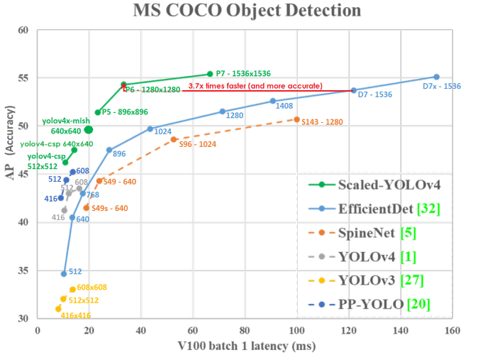
Proposed Model...
MS COCO
Fig.Yolov4 compared to other algorithms

Slide 22
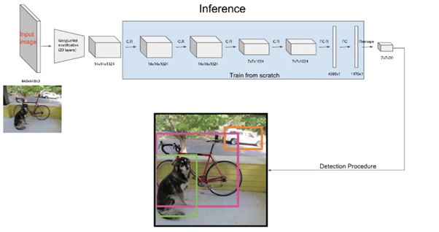
Proposed Model…
Offline Image Processing
Fig.-Block Diagram of Yolov4

Slide 23
Proposed Model…
Wit AI
Wit is a natural language interface for applications capable of turning sentences into structured data. It is developed by Facebook
Wit works with intents and entities.
Intents are used to understand the overall meaning of the sentence.
We train Wit by examples, or utterances
The app doesn't know a lot yet, but it will start to recognize the intent of getting information about the example. When Wit starts recognizing the utterance, the intent will be prefilled along with a level of confidence (between 0 and 1).
In Wit AI some authorization of application is also done by the user by using authorization bearer code and it is different for every account associated with that app.

Slide 24
Proposed Model…
Wit AI…
We are using Wit AI here to recognize the text in the audio matching with the intent. For ex-Turn off kitchen light.
Here we want to recognize the word kitchen in the given input by the user as a voice.
The first thing we're going to need is some kind of "wake word detection system". This will continuously listen to audio, waiting for a trigger phrase or word. When it hears this word it will wake up the rest of the system and start recording audio to capture whatever instructions the user has. Once the audio has been captured it will send it off to a server to be recognized. The server processes the audio and works out what the user is asking for.

Slide 25
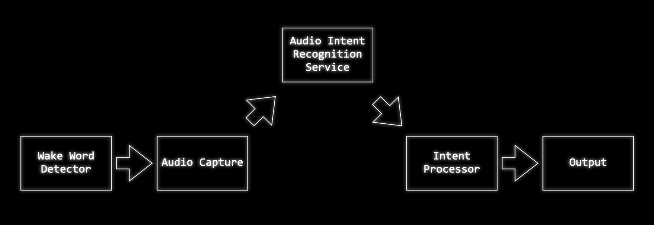
Proposed Model…
Wit AI…

Slide 26
Proposed Model
Mobile App
For the complete access of the SmartGlass , an android application is being used which will be equipped with features like tracking the beneficial data like object detection and other related results.
Featured with Connectivity Functions, Reminders, and complete customization of the smartglass and the smartband. The smartband data will be in sync with the smartglass and the application.
The customization options provided by the application will be setting up the accounts for various services i.e the search functionalities, map functionalities, and various other optional features like voice notifications, etc.

Slide 27
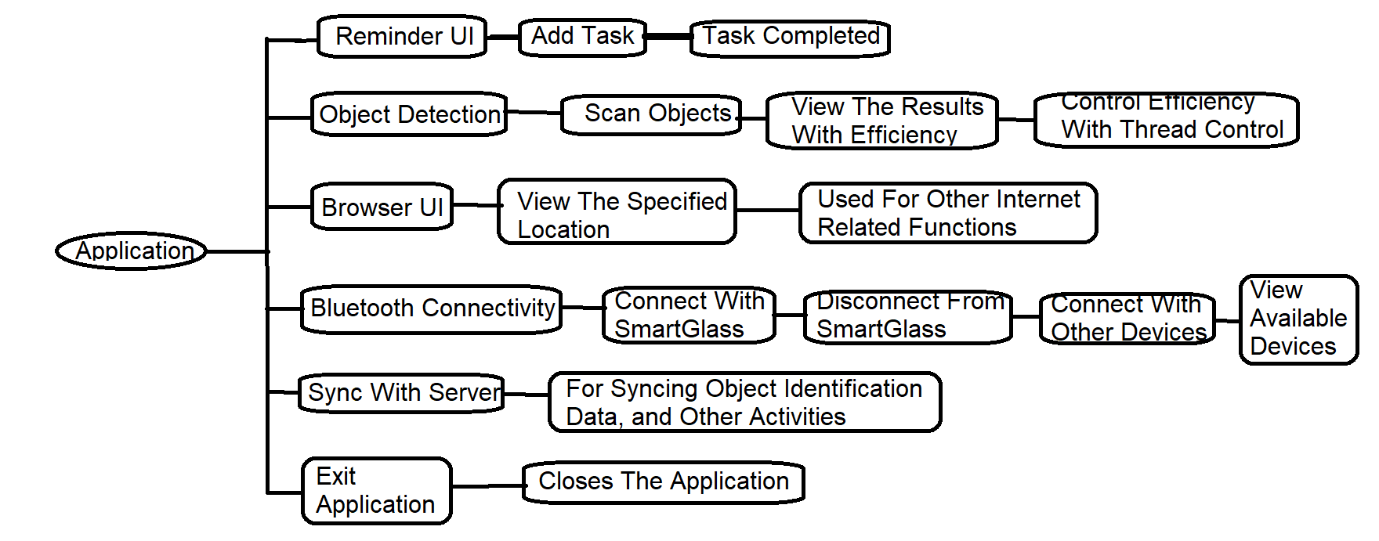
Proposed Model
Block Diagram of Android App
Fig.-Block Diagram of Android App

Slide 28
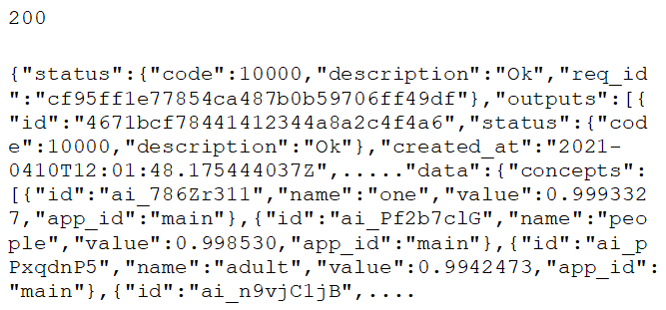
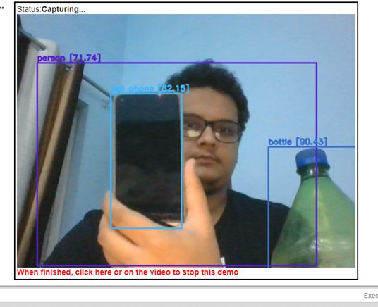
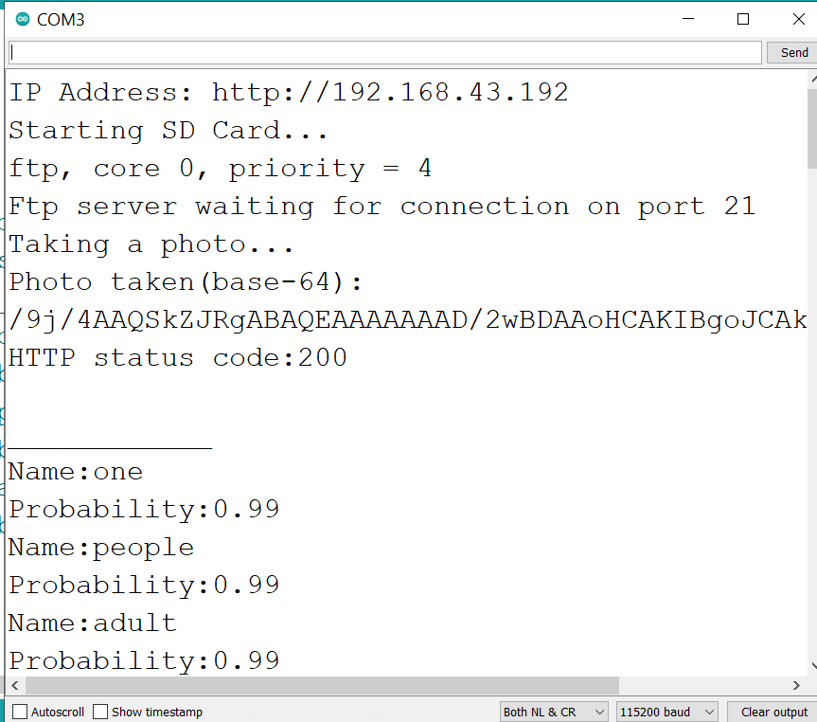
Results
Online & Offline Image Processing
JSON response feed
Online image processing output on serial monitor

Slide 29
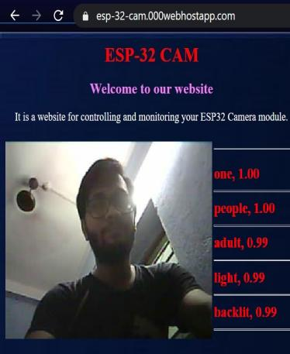
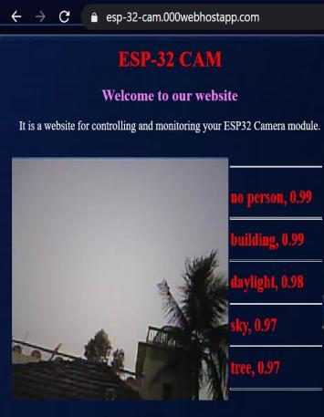
Results...
Output on Web-page

Slide 30
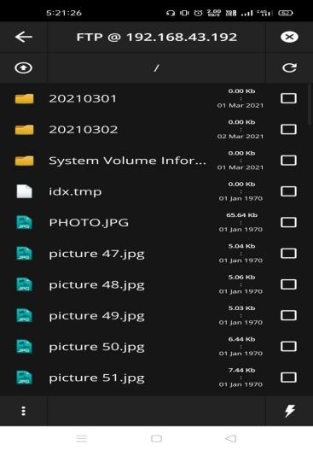
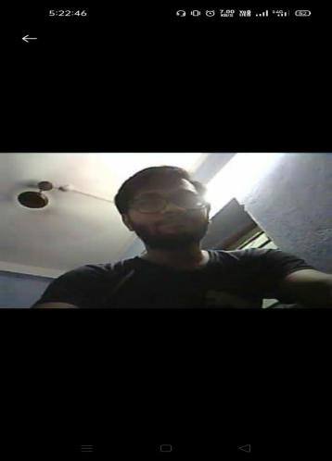
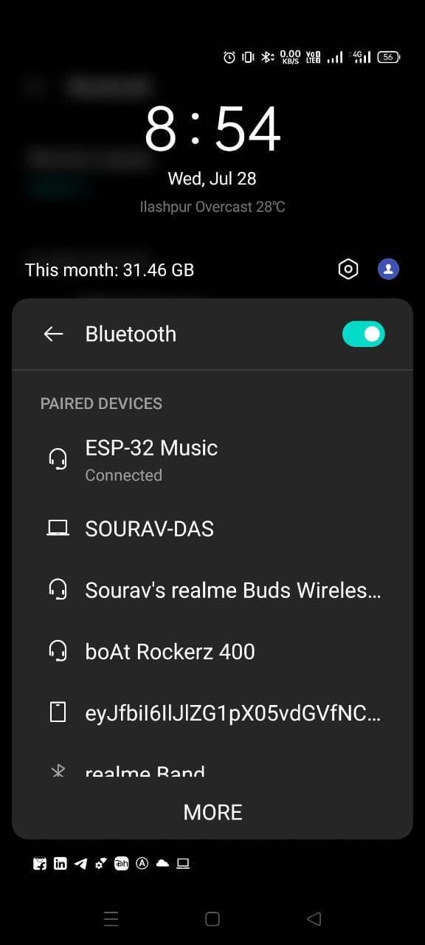
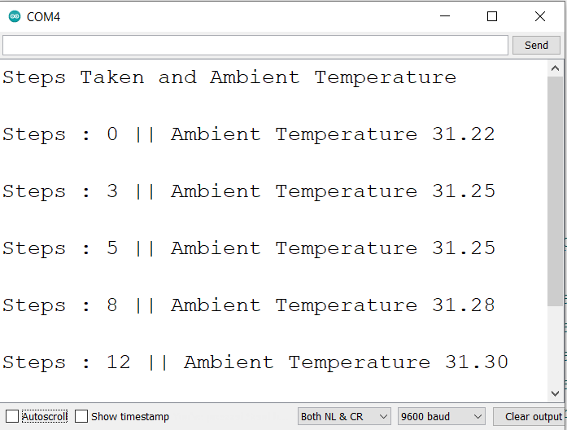
Results...
File Transfer Using FTP, Music & Call Over Bluetooth, Activity Tracking
Established Bluetooth connection between smart-glass and android
FTP file explorer
Downloaded image from ESP32
Steps counting and ambient temperature on serial monitor

Slide 31
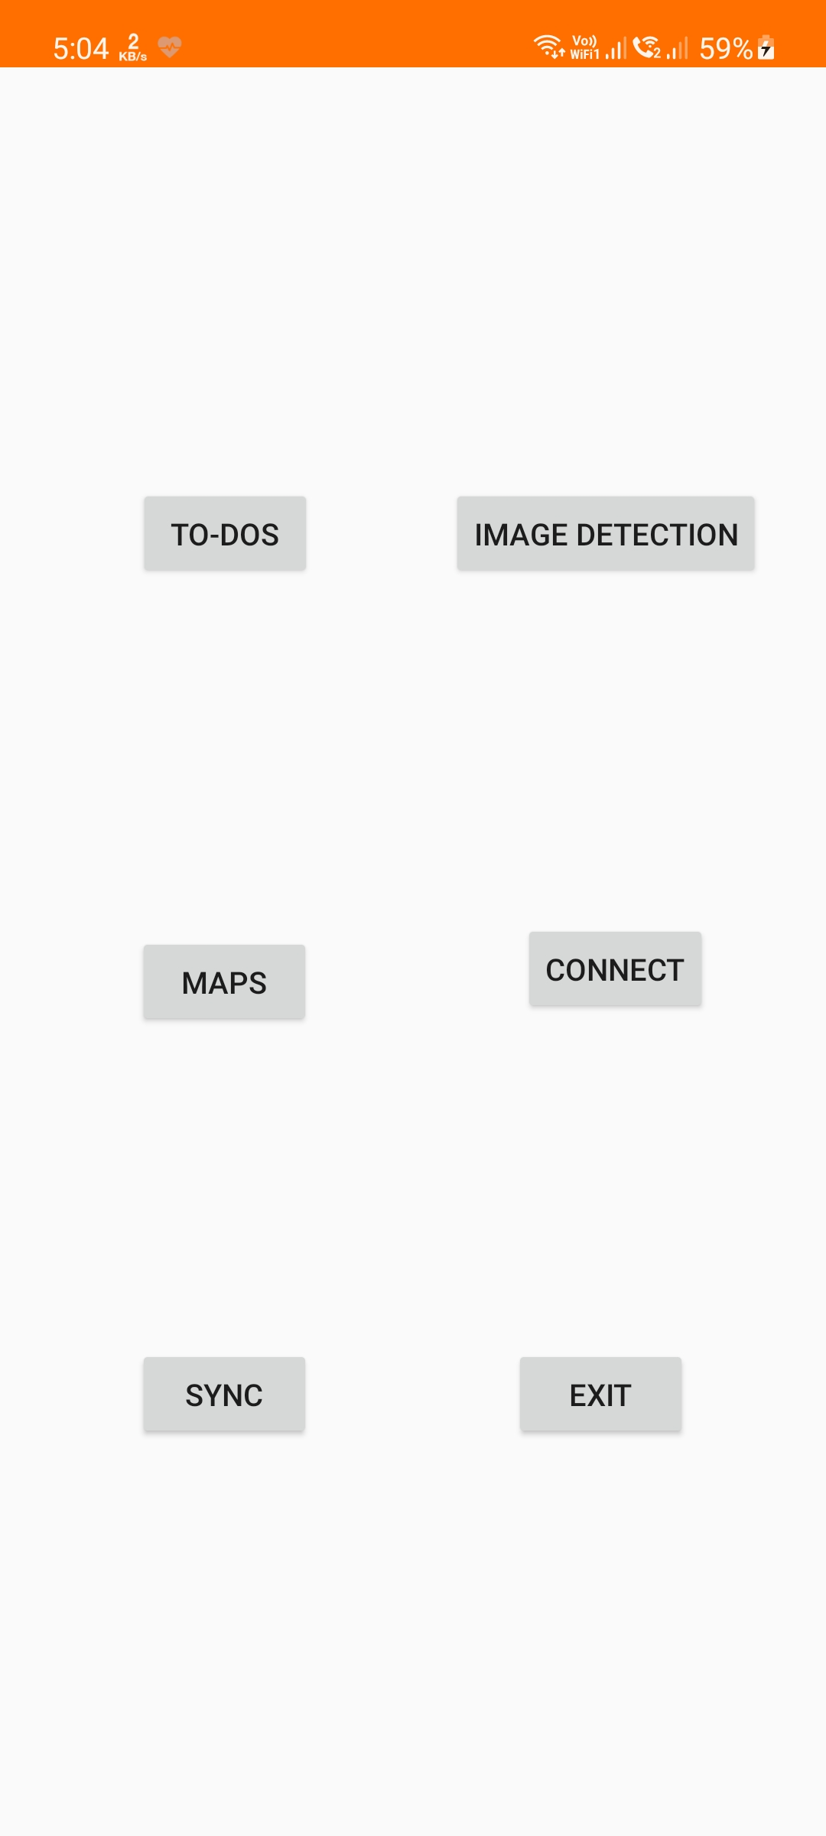
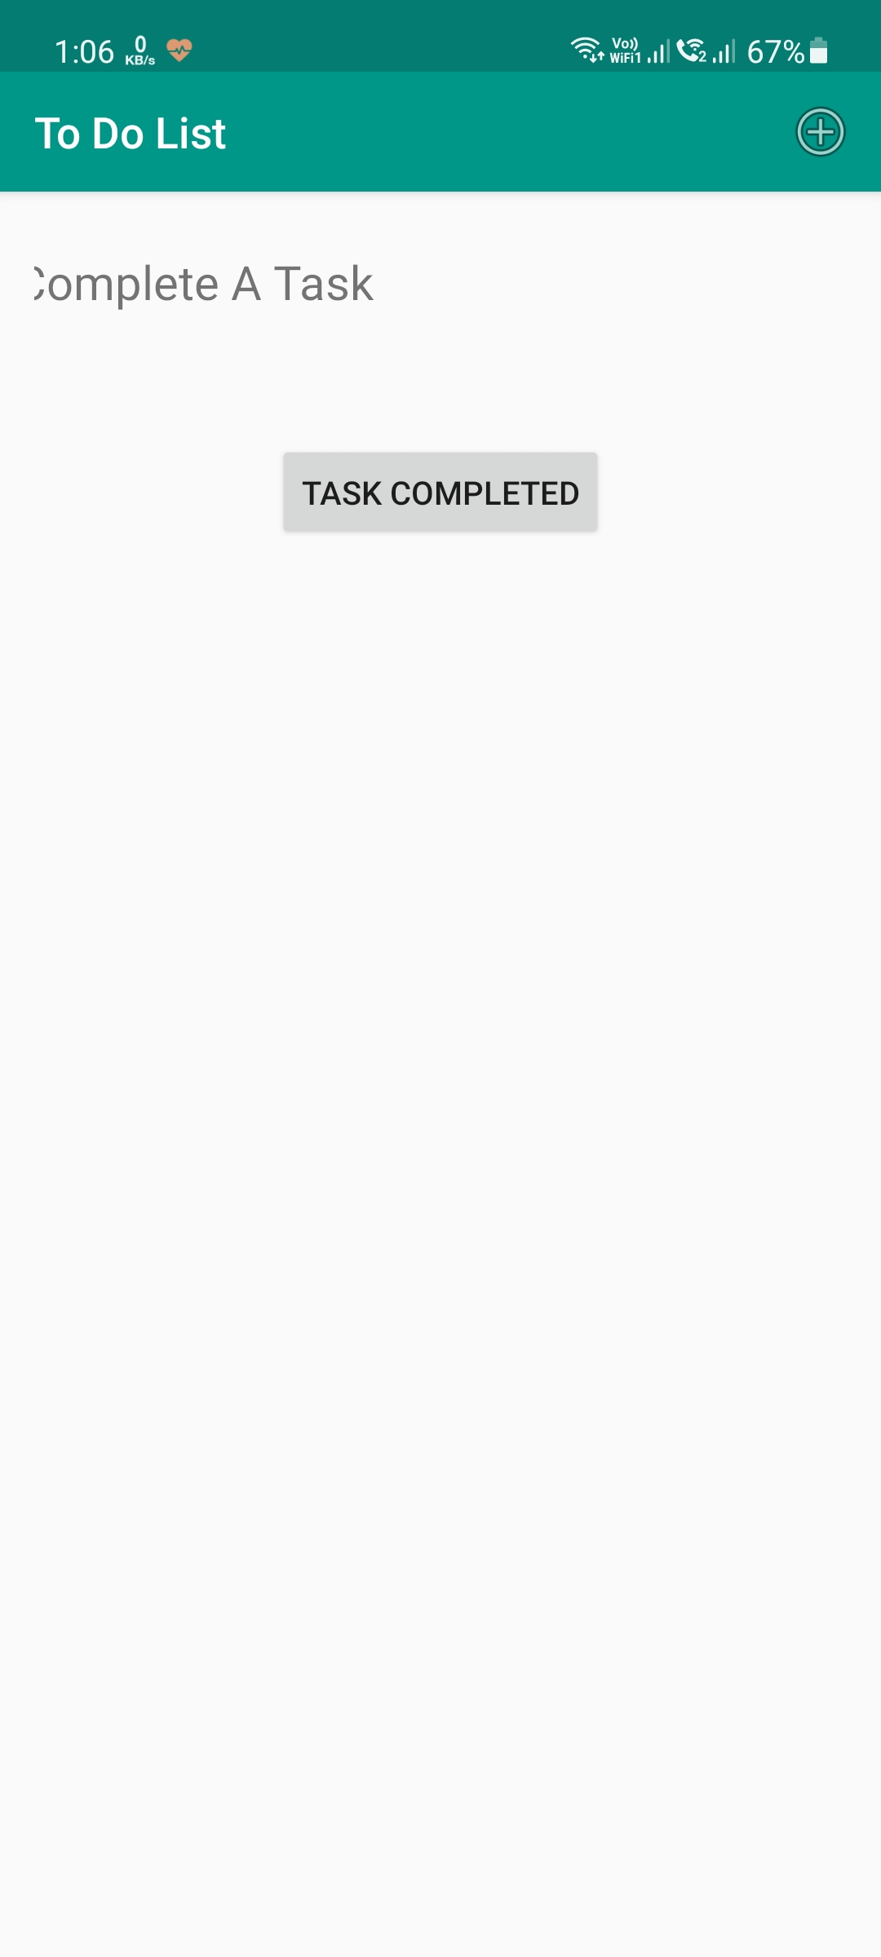

Results...
Android App
Fig. Home Page UI
Fig. To-do List UI
Fig. To-do List UI (No Reminders)

Slide 32
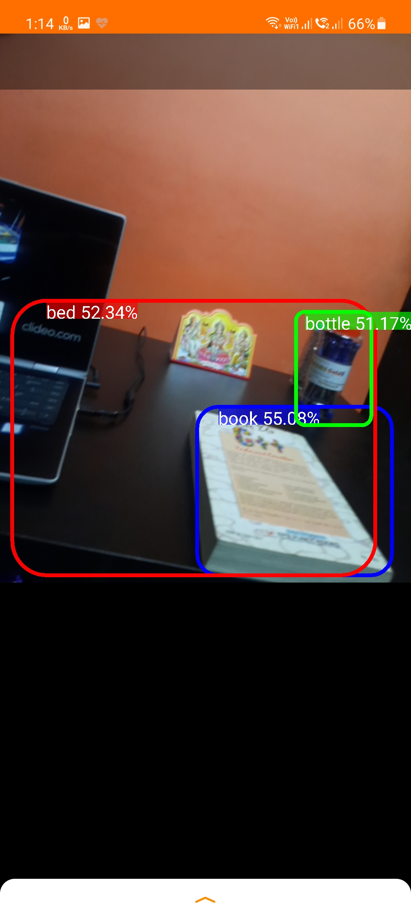
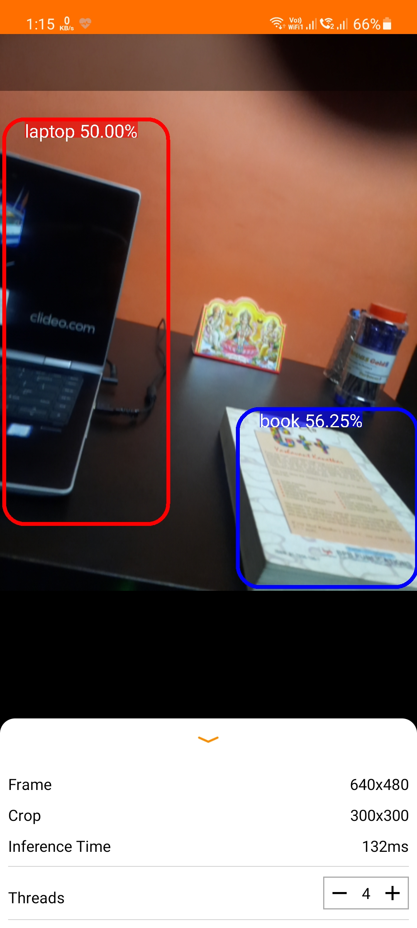
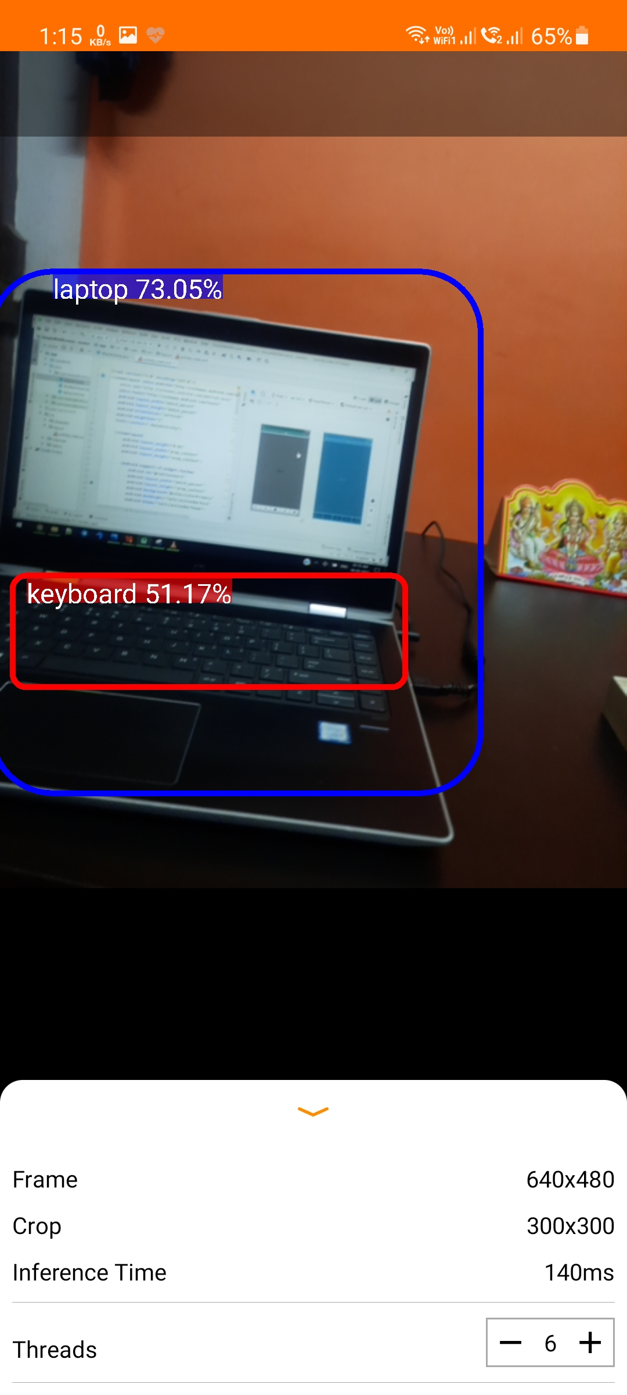
Results...
Android App Object Detection
Fig. Object Detection UI (Thread Control-4)
Fig. Object Detection UI
(Thread Control-6)
Fig. Object Detection UI

Slide 33
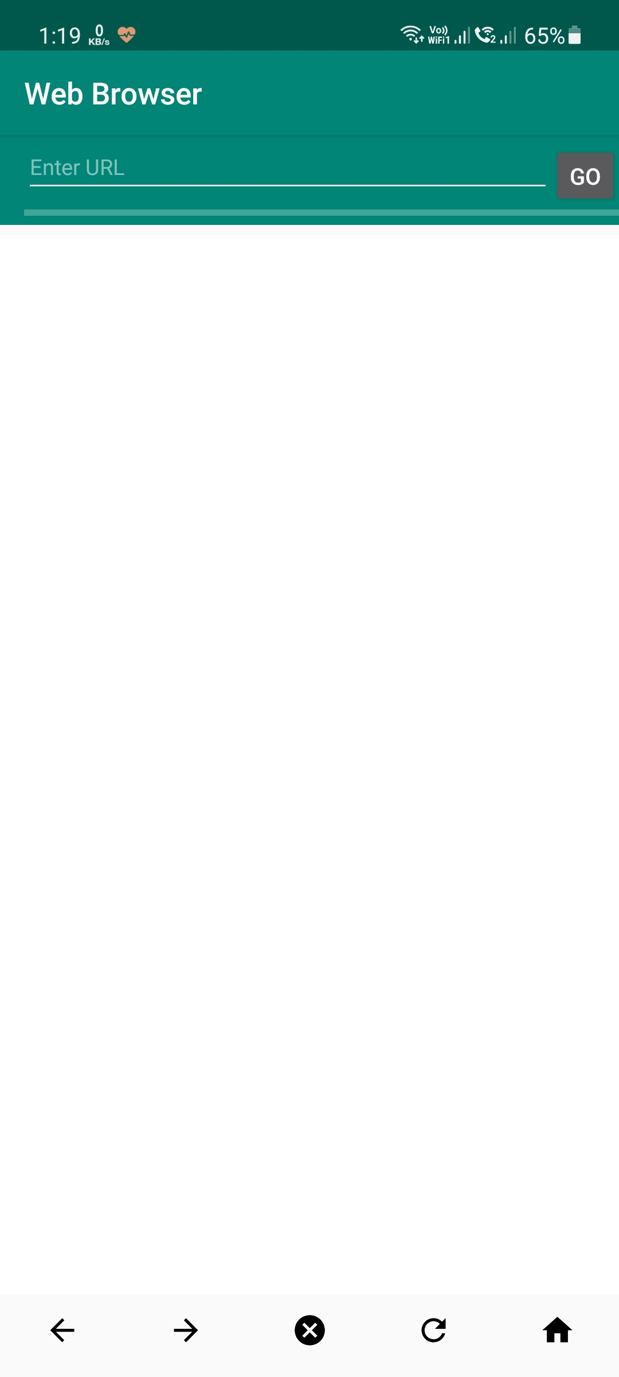
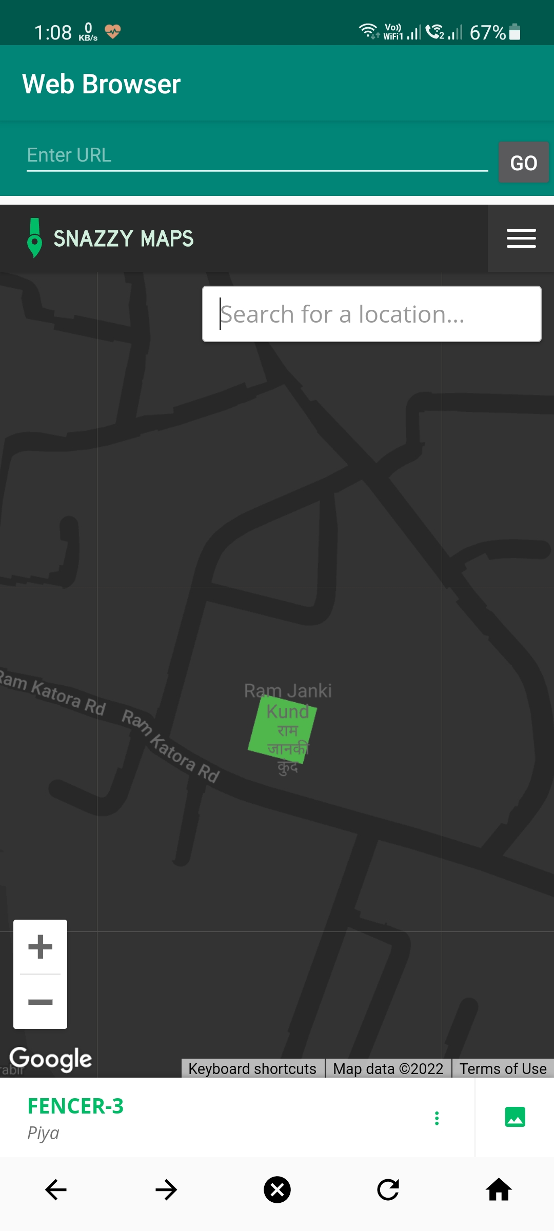
Results...
Android App Object Detection
Fig. Empty Browser UI
Fig. Browser with Maps UI

Slide 34
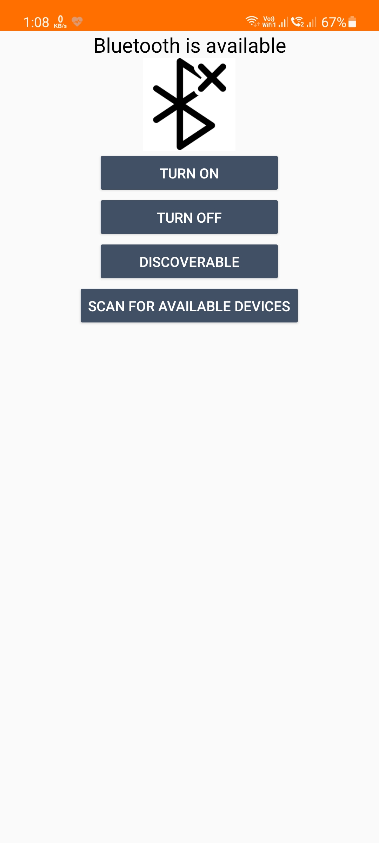
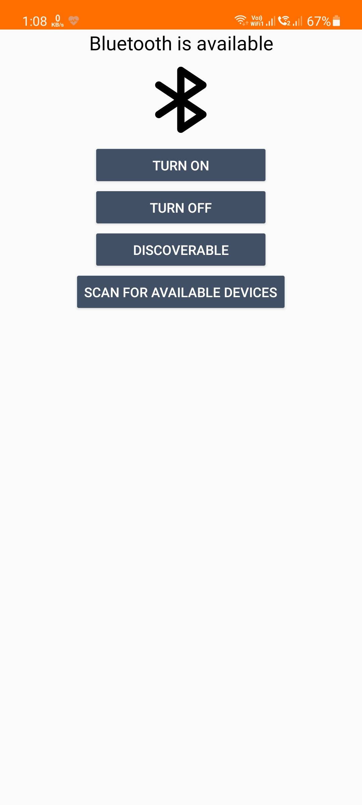
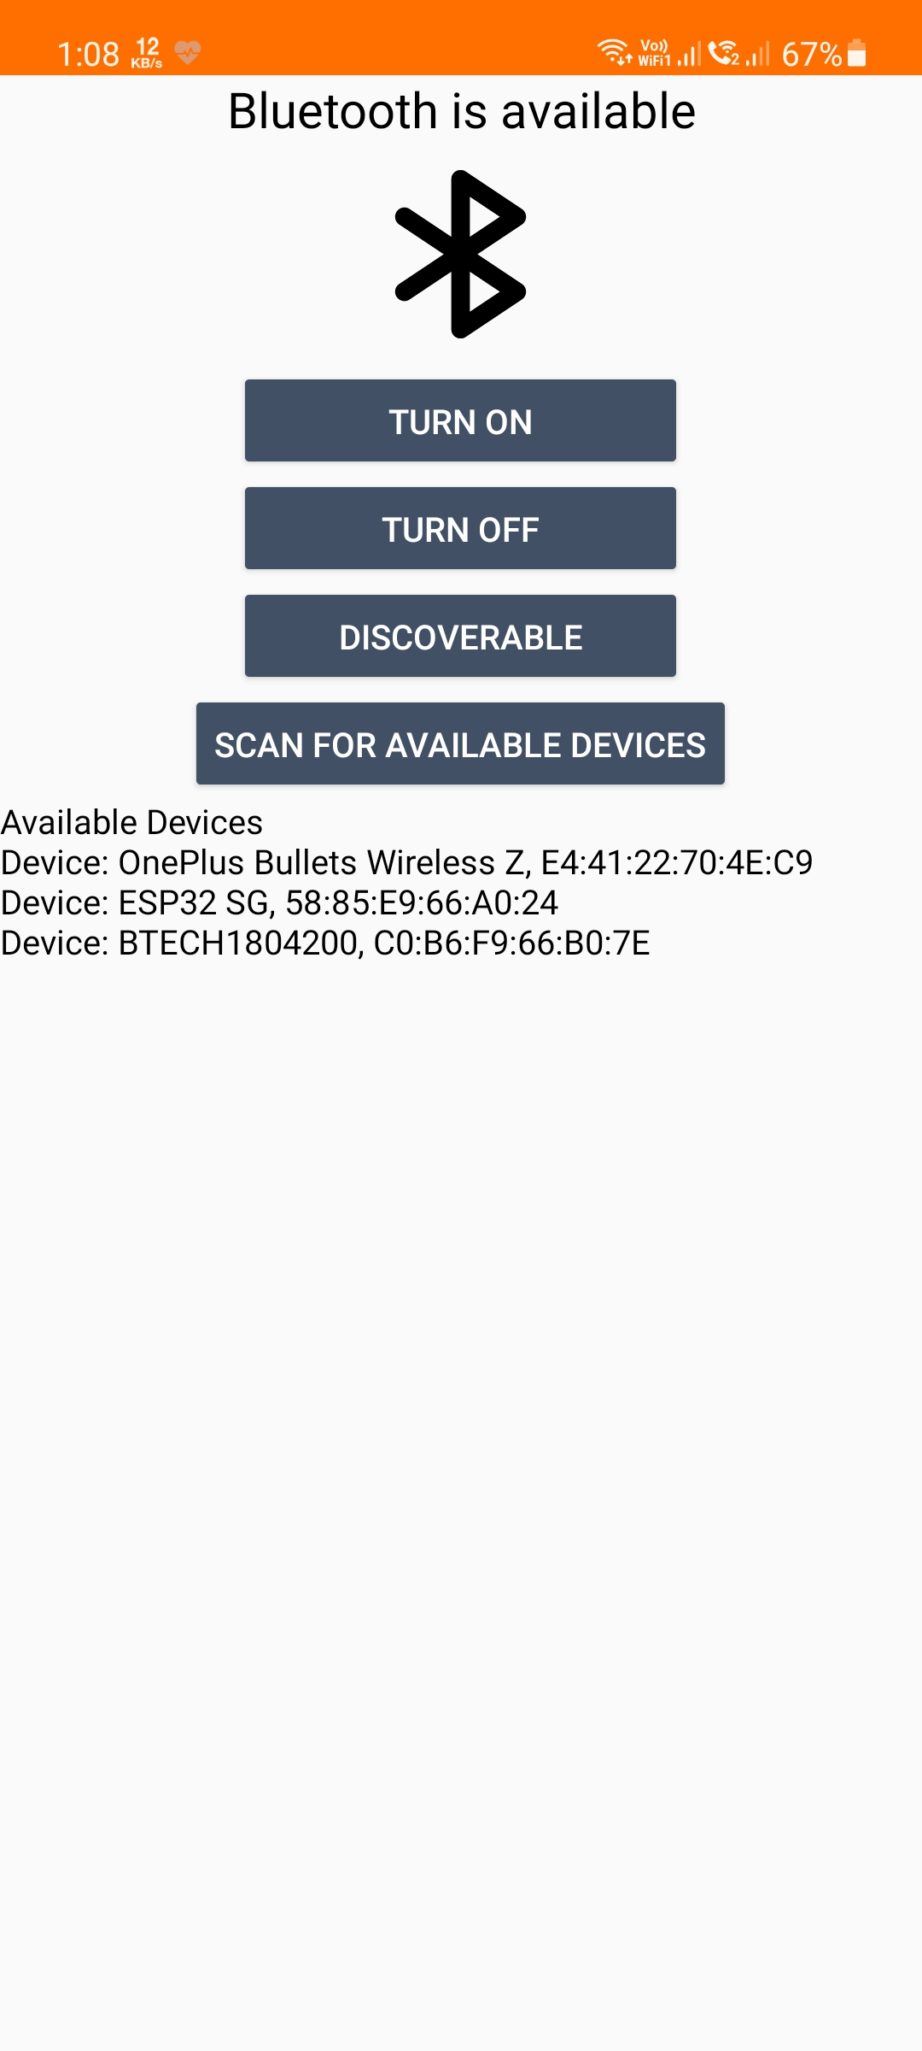
Results...
Android App
Fig. Bluetooth Off UI
Fig. Bluetooth On UI
Fig. Available Devices List UI

Slide 35
Milestone
6th Sem
Image capture & store
Object detection (online)
FTP protocol
HTML web page
April
2021
8th Sem
Google maps
Google assistant
Bluetooth calling and Music
Speech to Text detection
Final Prototype
April
2022
Nov
2021
7th Sem
Video capture & store
Object detection (offline)
TFT LCD/ display, Bluetooth speaker
App, MPU 6050

Slide 36
Conclusion
It appears that smart glasses have an outstanding opportunity for its growth along with its offerings in various regions.
In this solution the object detection using ML model is implemented and for blinds the audio signal corresponding to the object is generated using google assistant. Text to voice signal generation is also implemented by image processing with ML model and Google assistant.
Proposed smart glass supports blind people in many ways, it has the potential to change their life.
Technologies like smart glasses have proven to be a very important and beneficial invention for mankind. With regular improvements over time, these technologies will keep on making lives easier.

Slide 37
THANK TOU

